Slide 1
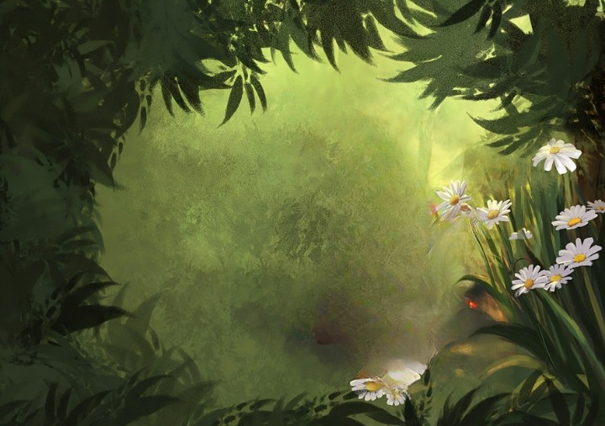
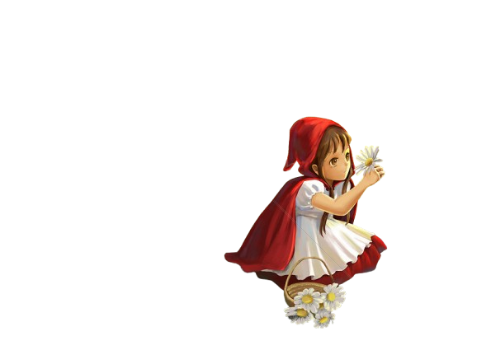

The Little Red Riding Hood

Slide 2
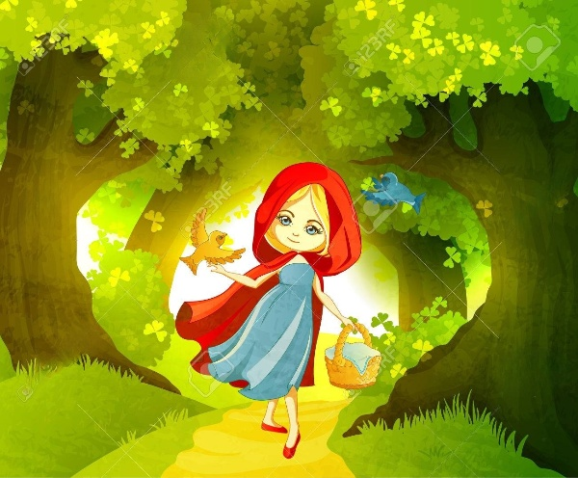
Once there lived a girl who lived in a happy forest. Everyone called her Little Riding Red Hood because she always a red hood.

Slide 3
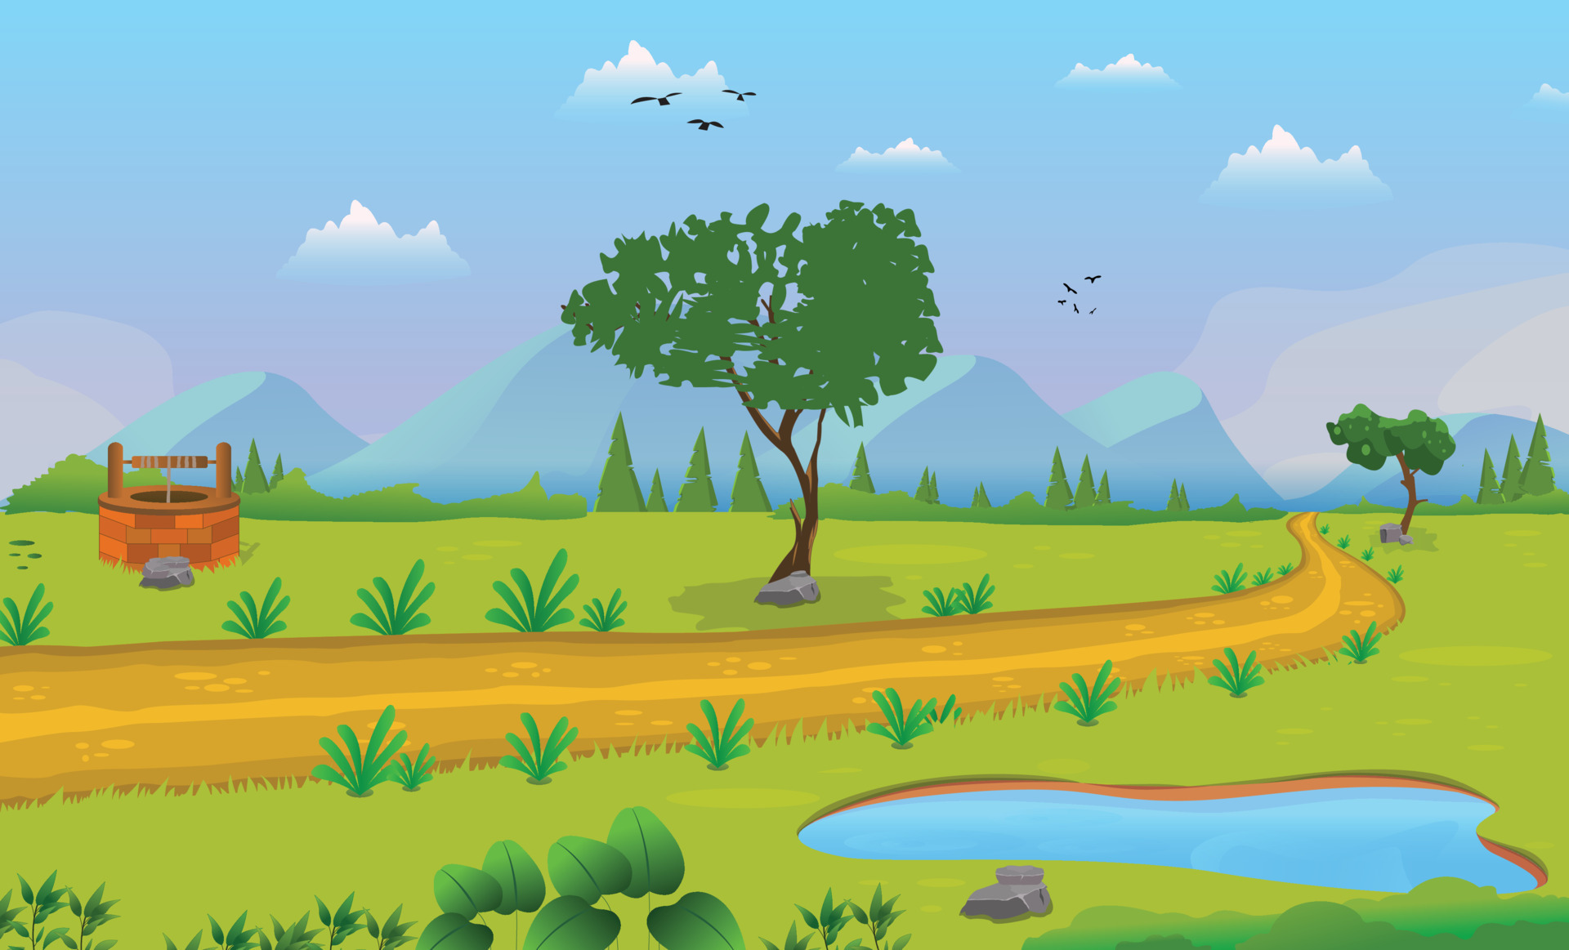
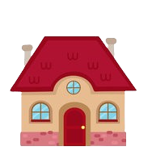
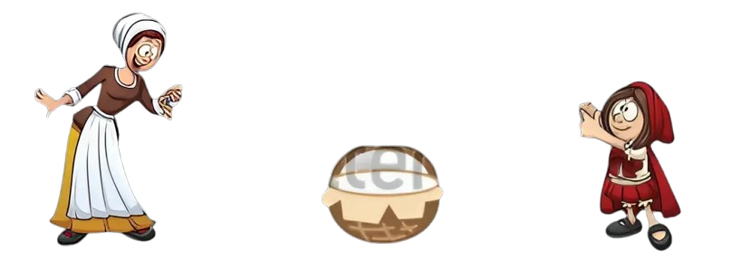
Hey Little Red Riding Hood, Your grandma is ill. Can you take this bucket to her.
Ok Aunt! I’ll give the basket to her.

Slide 4

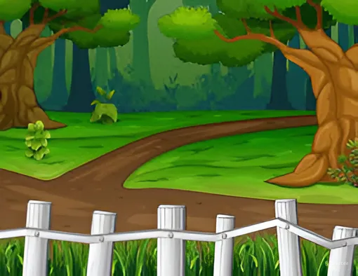

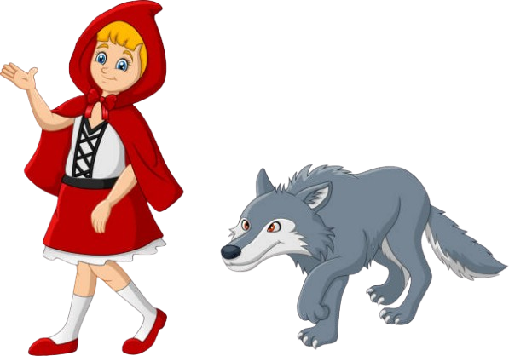


HMPH….HMPH
Wow!! There are a lot of beautiful flowers. I want to pluck some of it for my grandmother.
Oh Ok !! I appreciate your help.
.
Hey !! I am a good wolf. I overheard you. If you want to pluck some flowers, you can. I will tell your grandmother that you are on your way
HuH !! Who is there?? Please show yourself.

Slide 5
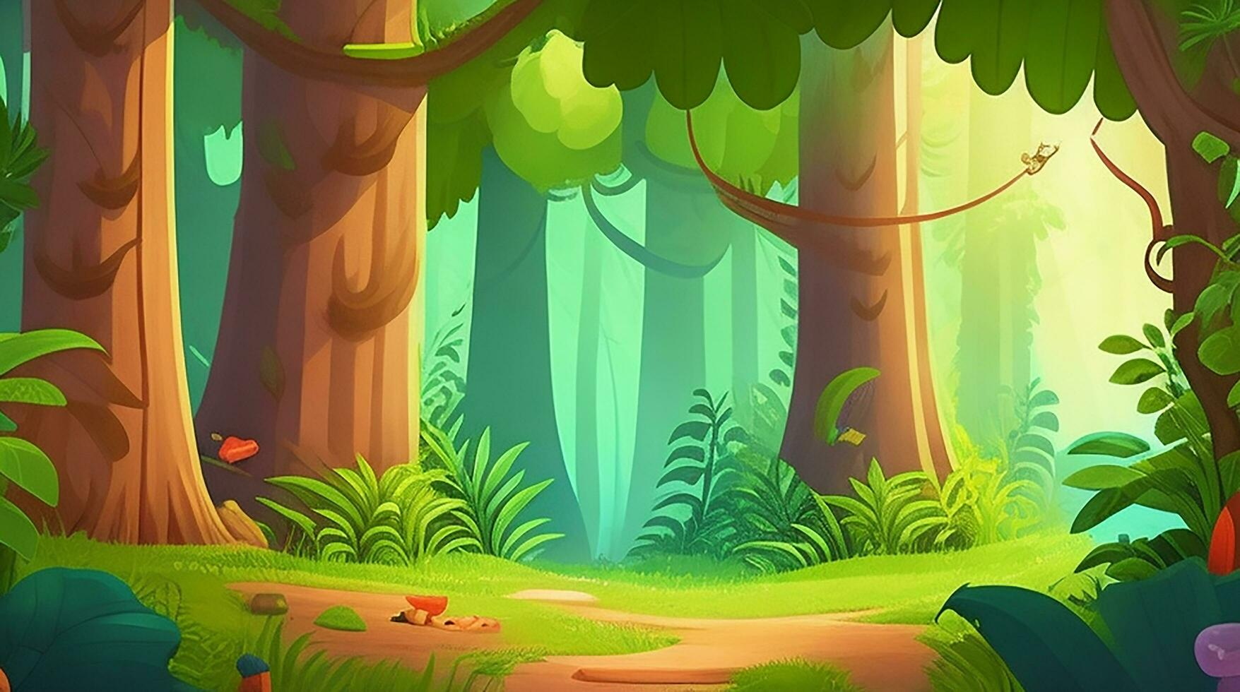
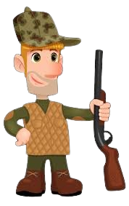
Hey Kid!! What happened to you?? Be careful, there are a lot of dangerous animal roaming around in this area.
Okay !! I’ll help you.
Actually, sir I got lost. Can you help me to find my grandmother’s house
Huh !! I got lost.

Slide 6
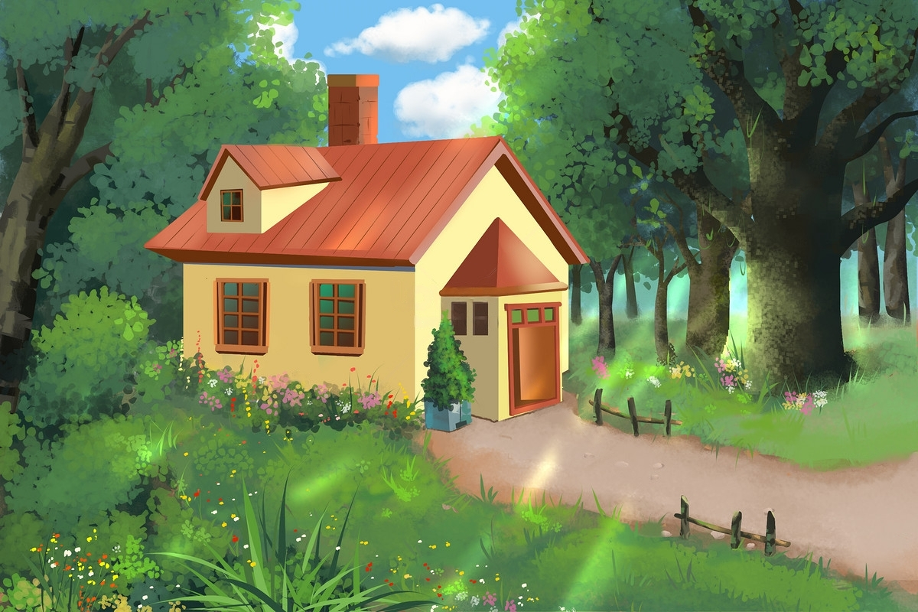
Please enter. It’s open.
Knock Knock!! Hey Granma is it’s me, Little Red Riding Hood.

Slide 7
Please enter. It’s open
Knock Knock!! Hey Granma is it’s me, Little Red Riding Hood
Yes!! It’s my Grandma’s House. Thanks Mister
Be Careful Next time. Bye!

Slide 8
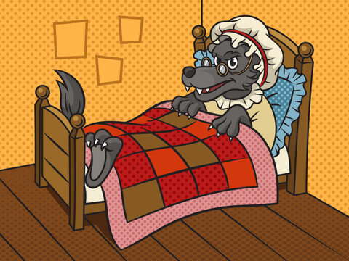
I really Appreciate that you brought a basket of fruits for me

Slide 9

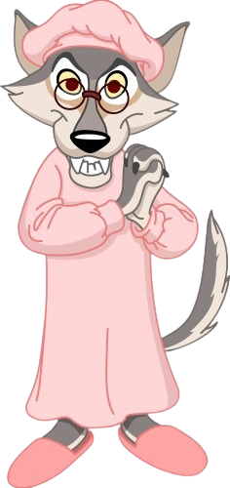
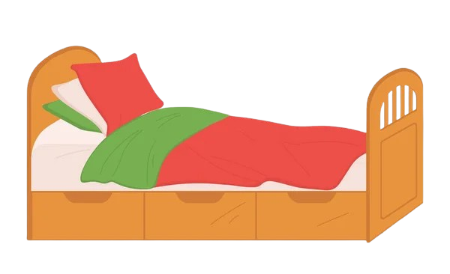
Because I am going to eat you. HAHAHA!!
That’s because I am ill.
What happened to you Grandmother?? Your voice and face seem different
What happened to your teeths?? Why are they so Long??
AHHH!! Help me!!

Slide 10
HUH!! What happened?? It’s the big bad wolf. I’ll punish you

Slide 12
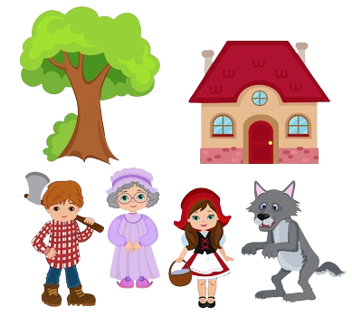
Thanks Mister! for saving me and my Granddaughter

Slide 13
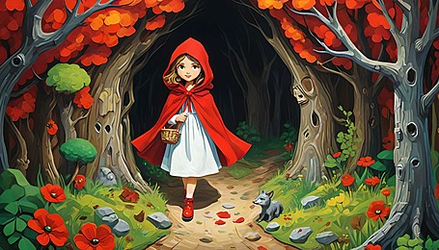
Submitted By: Umair Arshad
Roll no. : 2024-SE-38
Section : Software Engineering-D
Submitted to : Mam Rimsha/Mam Rida
Moral: Never trust strangers so easily.

